Slide 1
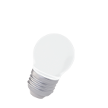
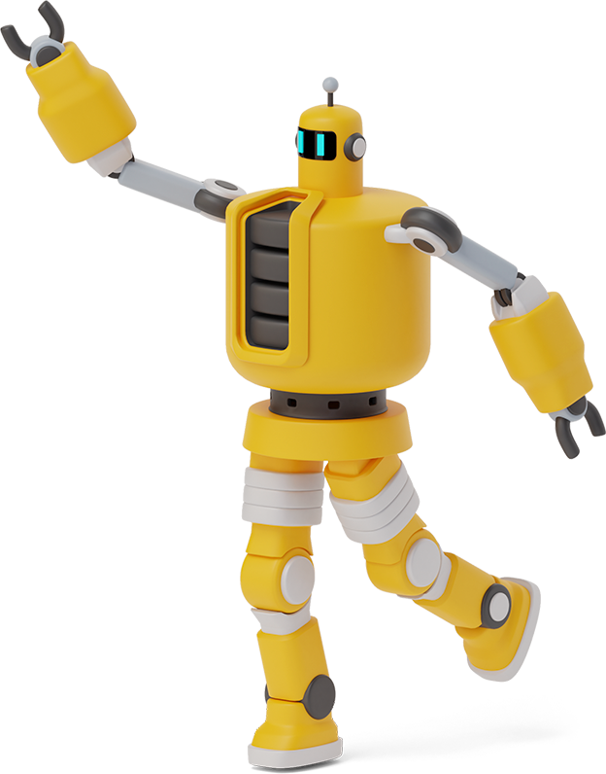
Python Playground

Slide 2
Roadmap
Homework Takeup
For Loops
Range() function
1
3
5
2
4
6
Review of Past Class
Class Activity
Class Activity

Slide 3
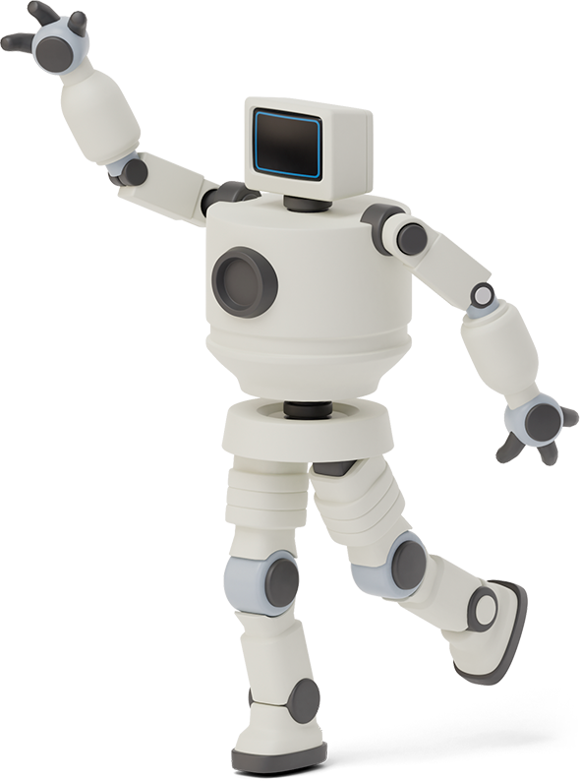

Homework Link
https://github.com/Asfandyar-Khan/PythonPlayground/blob/main/index.md
Contains all lectures and Google Colab notebooks
Contains homework which will be a word document
Does anyone have any homework questions?
New file – Python Project Ideas

Slide 4
Review of Last Week
Last week’s homework questions
Intro to functions
Using print functions inside our own functions
Doing math operations inside functions
Global vs. Local Variables
For Loops

Slide 5
This week...
Take up Week 5 Homework
Complete functions
For Loops
Range() function
Lists

Slide 6
Let’s Review Functions!

Slide 7
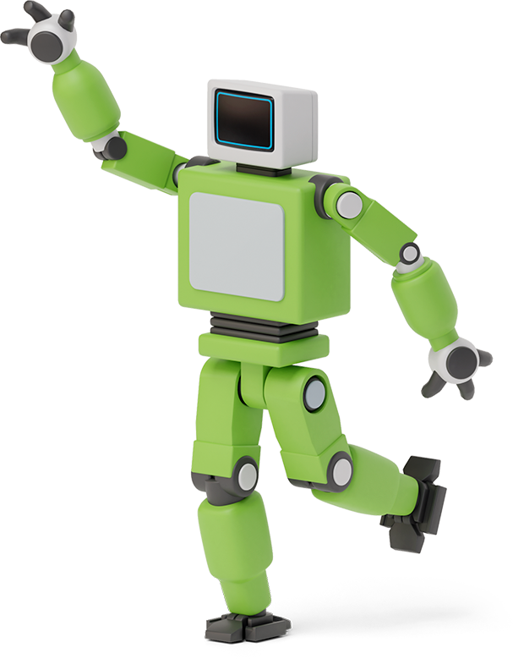


What is a Function?
A function is a set of statements that run when the function is called
Python has many built in functions!
print(), type(), int(), float(), str(), round()
What if we want to build our own functions?

Slide 8
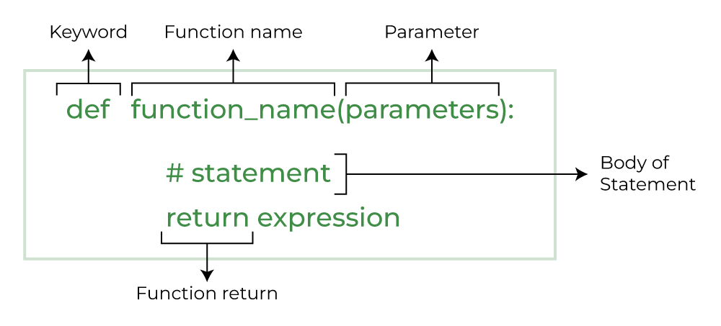
What is a Function?

Slide 9
Function Example
Write a function that outputs a few of the
introductory sentences we covered in
past classes
def favourite_sentences():
print(“My name is Bob”)
print(“My age is 10”)
Does anyone want to guess what this function will do?

Slide 10

Class Activity
Write a function called print_sentence(word, number) that multiplies the word by the number and prints it in a sentence like this:
WowWowWow! That was exciting!
Call the function like this:
print_sentence("Wow", 3)
Hint: Use word * number to repeat it and combine it with another sentence in print().

Slide 11

For Loops
A for loop iterates over a sequence – such as a string, list, or tuple
Allows you to run a block of code repeatedly
This occurs once for each item in the sequence
Syntax:
for item in iterable:
# Code to be executed for each item

Slide 12
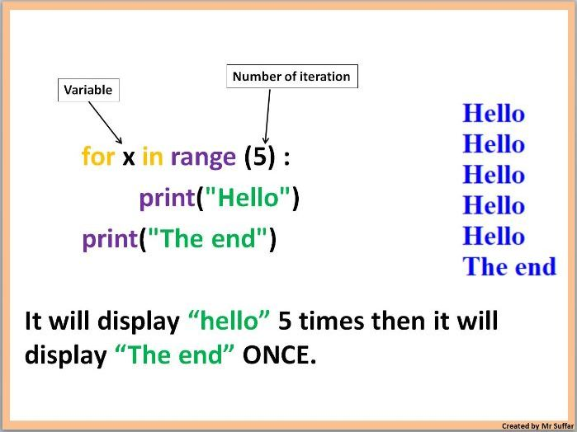
For Loops

Slide 13
For Loops – range() function
range() function
range(start,stop,step): 3 parameters
range(start): initiate the sequence of numbers with the start number
range(stop): will generate a sequence of numbers from 0 up to, but not including, stop
range(step): will jump between start and stop numbers by increment of step

Slide 14
Lists – Data Structure
Lists
Lists are a data structure that is used to collect data items
They are mutable (changeable)
Lists maintain a defined order
The first item is given priority
Then the second item, and so on...

Slide 15
Thanks!
Any questions?

